Slide 1

APEX 18.1
New Features
Martin B. Nielsen, MBNDATA
DOUG, Ballerup, 2018
MBNDATA

Slide 2
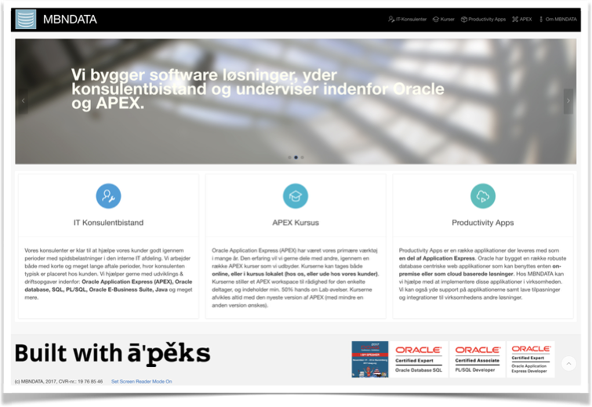





Application Express Developer
MBNDATA

Slide 3


What can we build with APEX
Internet
Intranet
MBNDATA

Slide 4
APEX Sweet Spot
MBNDATA

Slide 5
APEX Architecture
MBNDATA

Slide 6
APEX History
MBNDATA

Slide 7

APEX 18.1 Major New features
REST Enabled SQL support & Service consumption
Create App Wizard (Blueprint/LowCode)
MAJOR
Oracle JET Upgrade to latest version (4.2)
Social Login (Google, Facebook, OAuth2…)
Page Designer Improvements
Many many other improvements…
MBNDATA

Slide 8
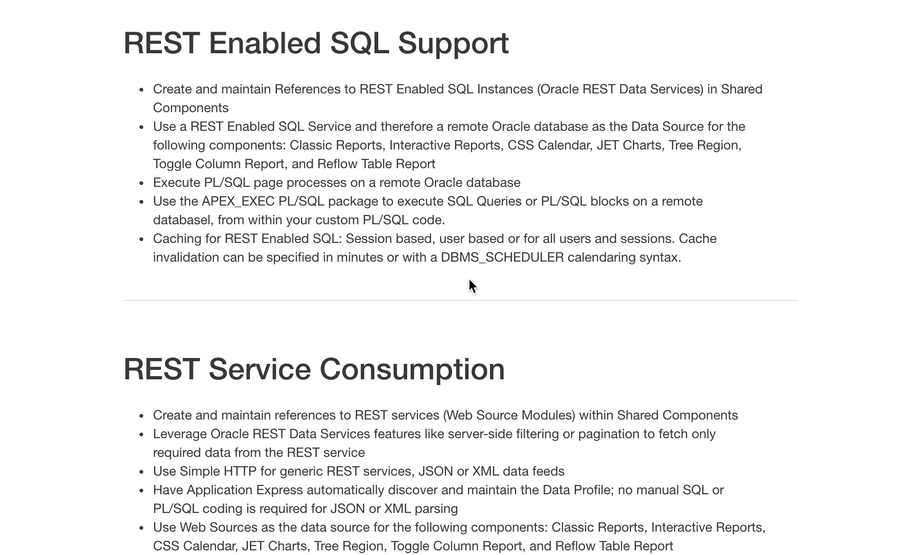
APEX 18.1 ALL features
MBNDATA

Slide 9



APEX 18.1 REST features
REST
Datasources - NOW
Regions:
Classic Reports,
Interactive Reports,
CSS Calendar,
JET Charts,
Tree Region
Custom Programming/
Legacy web services
Database
Link
Browser
Mid Tier
Database Tier
(Local)
MBNDATA

Slide 10
APEX 18.1 REST features
Datasources - APEX 18.1
Remote
Datasources
REST
REST /
JSON
LowCode
Regions:
Classic Reports,
Interactive Reports,
CSS Calendar,
JET Charts,
Tree Region
Browser
Mid Tier
Database Tier
(Local)
MBNDATA

Slide 11
APEX 18.1 REST datasources
MBNDATA

Slide 12
APEX 18.1 REST Web Sources
MBNDATA

Slide 13
APEX 18.1 REST Caching & processing
REST Enabled SQL Service
Web Source
MBNDATA

Slide 14
APEX 18.1 REST API
MBNDATA

Slide 15
APEX 18.1
REST
DEMO
MBNDATA

Slide 16
APEX 18.1 Create App Wizard
Quick SQL Integration
Application creation from Quick SQL
MBNDATA

Slide 17
APEX 18.1 Blueprint
Blueprint (JSON)
MBNDATA

Slide 18
APEX 18.1 Features
MBNDATA

Slide 19
APEX 18.1 Administration Page
MBNDATA

Slide 20
APEX 18.1
Create Application
DEMO
MBNDATA

Slide 21
APEX 18.1 JET 4.2 Integration

Slide 22
APEX 18.1 JET 4.2 Integration
Fill Gaps in Chart Data
Sort order (4 options)
New series level attributetes
…
JS Stack Upgrade
MBNDATA

Slide 23
APEX 18.1 JET 4.2 Integration
Integration of other JET visualisations - using code or plugins
REST/
JSON
* Oracle JET Cookbook
MBNDATA

Slide 24
APEX 18.1
JET Charts
DEMO
MBNDATA

Slide 25

APEX 18.1 Social Login
OAuth2
MBNDATA

Slide 26
APEX 18.1 Social Login
1. Setup provider credentials (client id and key)
3. Log in
2. Create credentials in APEX
MBNDATA

Slide 27
APEX 18.1
Social Login
DEMO
MBNDATA

Slide 28
APEX 18.1 Other features
MBNDATA

Slide 29
APEX 18.1 JavaScript Documentation
MBNDATA

Slide 30
APEX 18.1 New regions
Smart Column Setup for
hide first,
Hide last…
Smart Column Setup for
hide first,
Hide last…
MBNDATA

Slide 31
APEX 18.1 New regions
Regions are gradually copied from the
mobile theme to the desktop theme.
APEX is moving away from jQuery mobile
And integrating into the universal theme.
MBNDATA

Slide 32
APEX 18.1 Page Designer
MBNDATA

Slide 33
APEX 18.1 Grid Improvements
* More spreadsheet like features
* More dynamic action events
MBNDATA

Slide 34
Questions
?
MBNDATA

Slide 35
https://apexea.oracle.com/
Try the new version
Github example application and presentations here…
MBNDATA

